Slide 1
Introduction to the Universal Wellbeing Model (UWM) and Universal Wellbeing Evaluation Tool(UWET)
SUSAN F. STEVENSON
Cheif Executive Director

Slide 2
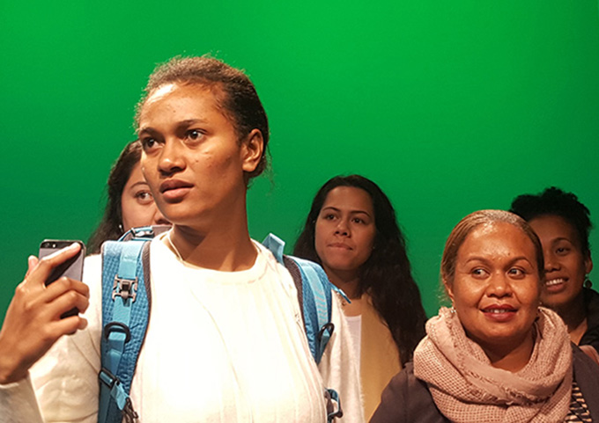
Pathway to the Universal Wellbeing Model
The Universal Wellbeing Model (UWM) has been developed through:
themed literature review,
theoretical and applied practice research that commenced in 2006.
In 2008 in order to respond to the needs of Māori, Pacific Island, and Disabled students in a South Auckland in Pacific Island focused Institution, staff implemented…

Slide 3
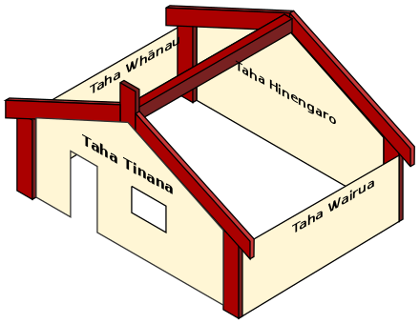
Pathway to the Universal Wellbeing Model
Whare Tapa Whā (Durie, 1984)
The model was supported student achievement so in 2009 (supported by an Ako Aotearoa Best Practice Research Grant the outcomes of this model were investigated and published (Schofield, Walker & Going, 2011).
Key Success Factors were:
Stability of pastoral support staff
Holistic nature of pastoral care supports
Limits were:
Lack of an whenua dimension to guide staff to respond to diverse students
Lack of an evidence-base

Slide 4
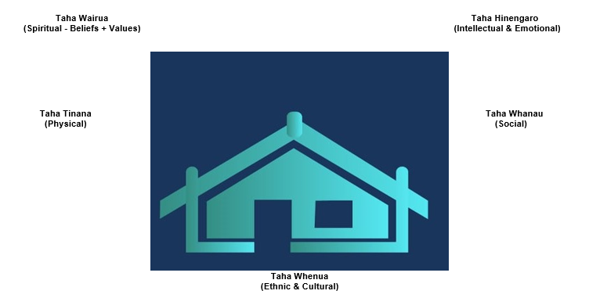
Pathway to the Universal Wellbeing Model
Whare Tapa Rima (Moeau, 1997)
Proposed Hauora – Whare Tapa Rima
during development of the New Zealand Health & Physical
Education Curricula and at a H & PE Conference.
This model included a Whenua (ethnicity and culture) dimension.
Review with a Māori Advisory Board supported the view this model had ancient roots and has long been utilised by all Māori.

Slide 5
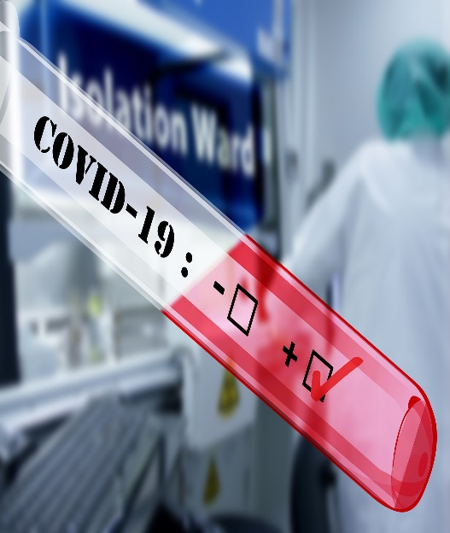
Pathway to the Universal Wellbeing Model
Whare Tapa Rima (Moeau, 1997)
The new model improved student achievements, and retention plus reduced student withdrawals.
In 2018 and supported by an Ako Aotearoa Best Practice Research Grant implementation of this model was investigated (through a COVID lockdown) and published through a Digital Film and Research Report
(Fielden, Stevenson, Going, Grant, & Zagala, 2020).
Key Success Factors were:
Joint student and staff understandings of and support for the model
Caring family/whānau/community environment created

Slide 6
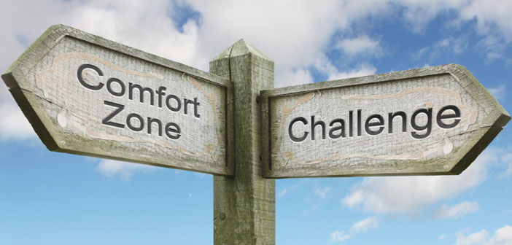
Pathway to the Universal Wellbeing Model
Whare Tapa Rima (Moeau, 1997)
Limits were:
Ability, and desire of diverse people to relate to a model from another ethnic group and
largely presented in another language (may not feel client/student centric)
Does not guide professional practice for wellbeing and pastoral care facilitators

Slide 7
Pathway to the Universal Wellbeing Model
Whare Tapa Rima (Moeau, 1997)
Ongoing Questions
Does this model have the capacity to support diverse peoples?
Can non Māori feel culturally safe - confident using this ancient Māori model?
Challenges to:
Defining the terminology used
The evidence base supporting the model
Broad applicability to diverse populations

Slide 8
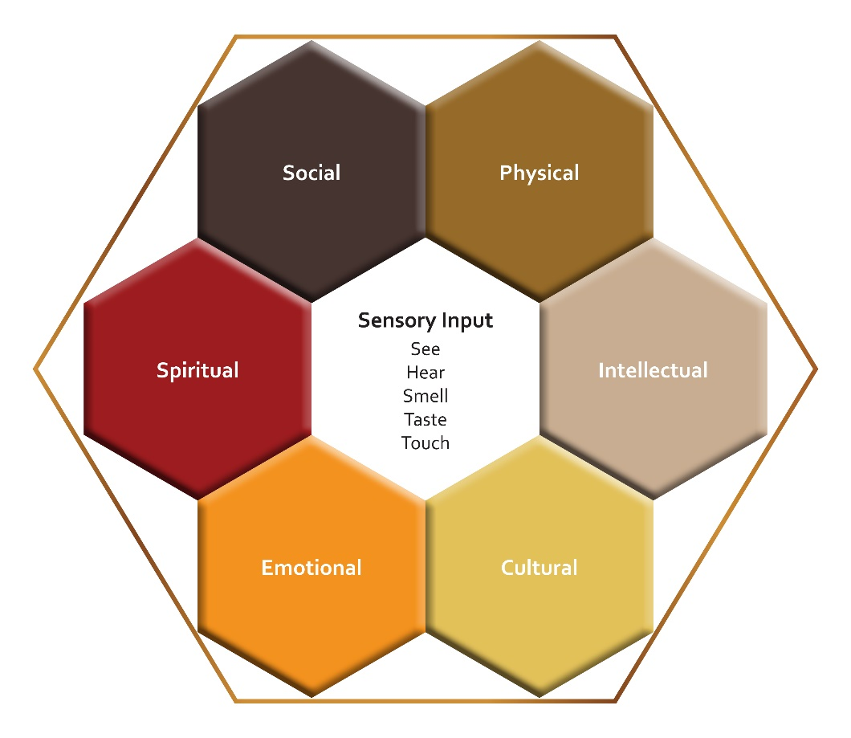
Universal Wellbeing Model (UWM)
(Stevenson, Gurung & Zagala, 2022)
(Social, Physical, Intellectual, Cultural, Emotional & Spiritual = SPICES)

Slide 9
The Universal Wellbeing Model (UWM)
Purpose
The Universal Wellbeing Model (UWM) was designed to:
explain integrated wellbeing,
guide wellbeing facilitator practice
improve the research-ability of wellbeing
heighten wellbeing programme outcomes
empower self- referring adult individuals, families, whānau and teams

Slide 10
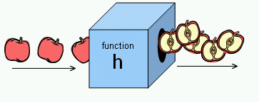
The Universal Wellbeing Model (UWM)
Function
The Universal Wellbeing Model (UWM) was created to perform the following functions:
Educate and facilitate optimal levels of wellbeing
Empower Professional Wellbeing Facilitators working in:
Holistic Wellbeing Enhancement
Pastoral Care and
Health Education contexts

Slide 11
Universal Wellbeing Model Components
Sensory Input received through interactive experiences, what we…
see
hear
smell
taste
and touch
With ourselves, others, materials and our environment.

Slide 12
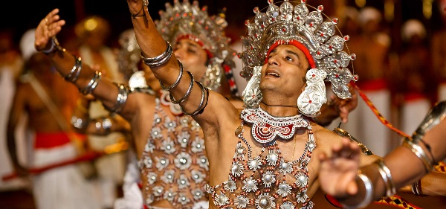
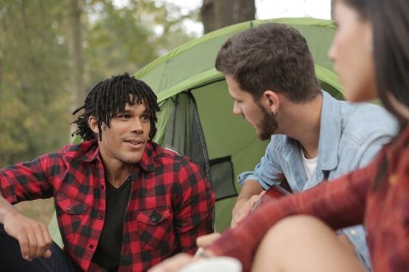
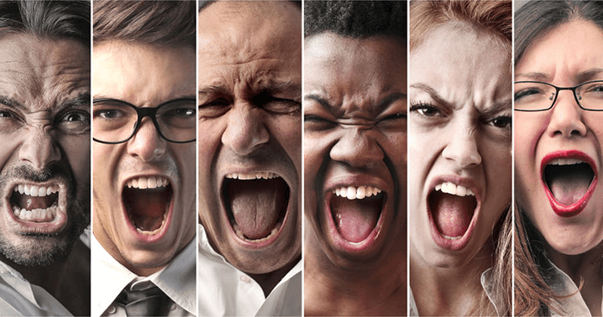
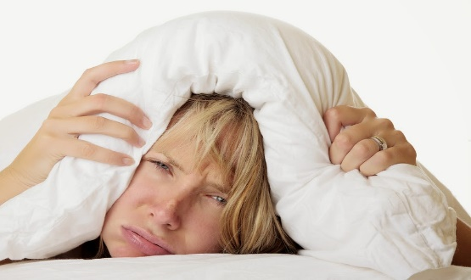
Universal Wellbeing Model Components
Plus the following evidence-based determinants of wellbeing under the following six dimension headings (SPICES) :
Social
Physical
Intellectual
Cultural
Emotional
Spiritual

Slide 13
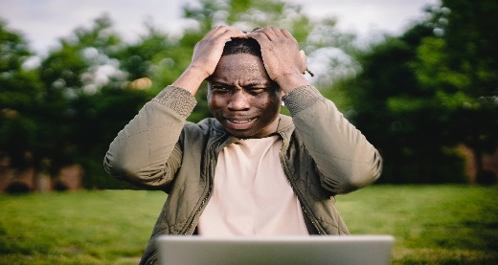
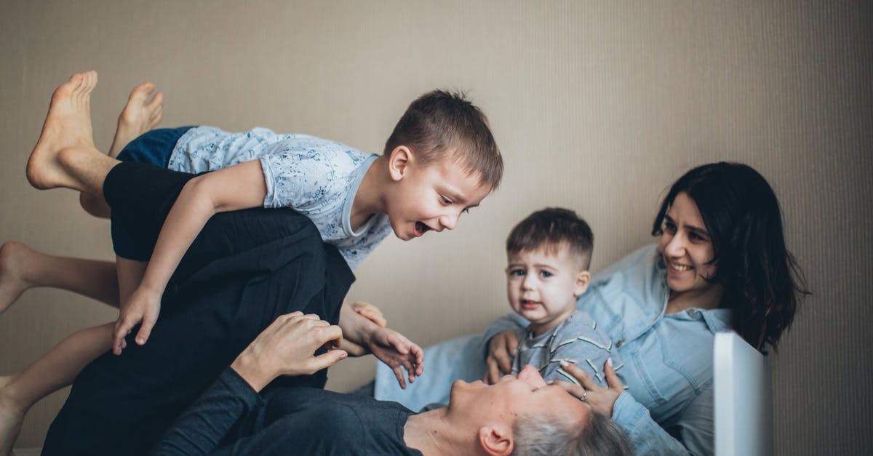
SOCIAL –This includes social interactions with…
ourselves (intra-psychological),
those closest to us (inter-psychological - significant others),
our family/whanau,
organisations, iwi, workplaces and our community context

Slide 14
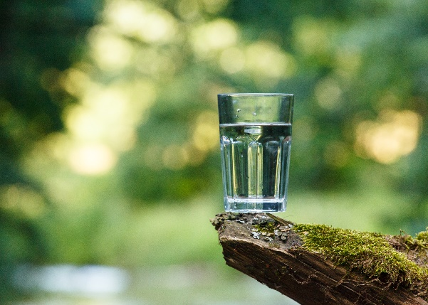
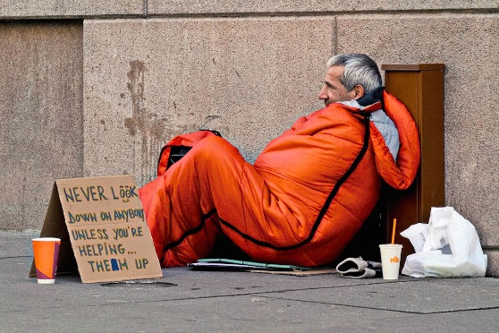
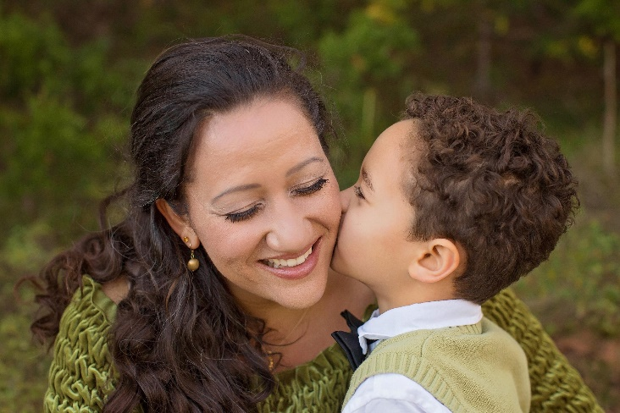
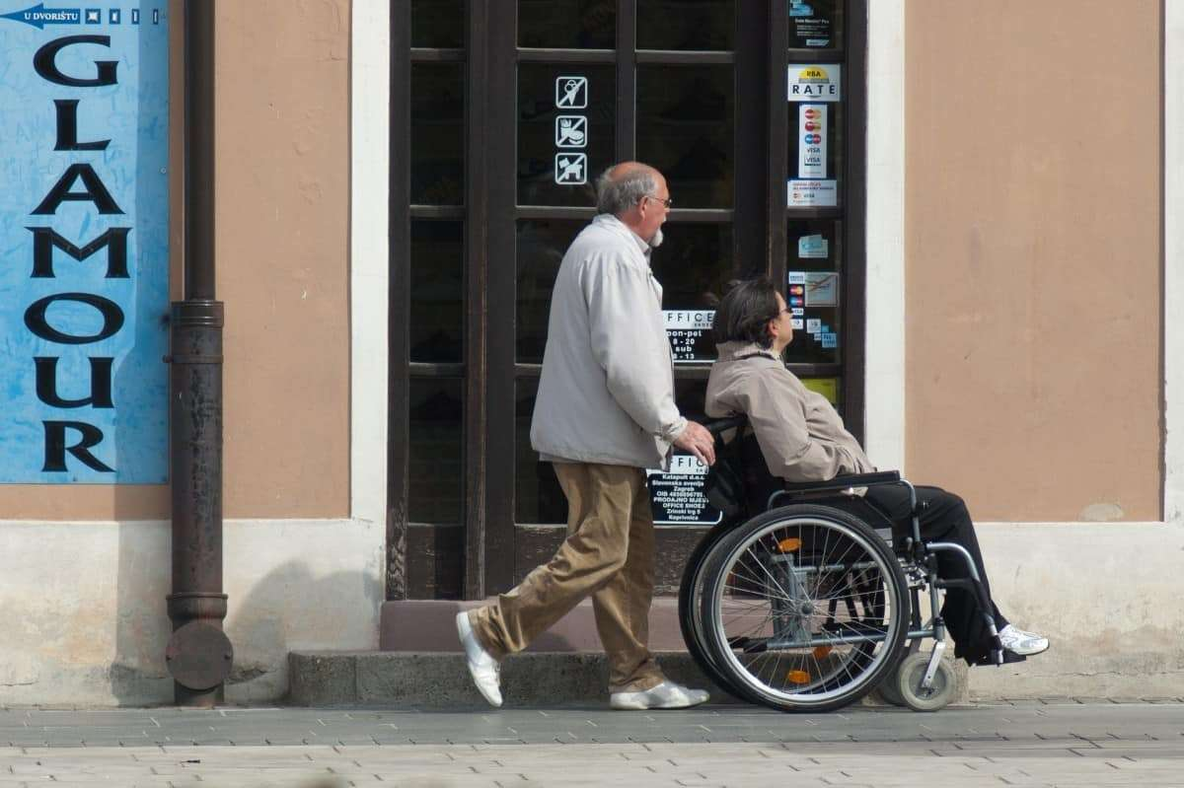
Physical – including…
PHYSICAL
In Brief this dimension includes
Food
Water
Exercise
Affection
Warmth
Sleep
Fresh air
Shelter
Freedom from dis-ease
Financial means
Physical safety and
So on…

Slide 15
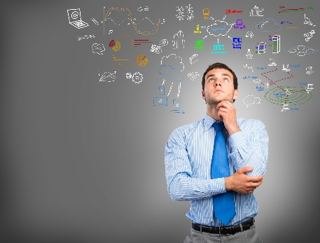
Intellectual – Including…
Our awareness, knowledge and skills related to:
i) our thinking styles, patterns, processes, and strategies
(such as how we make decisions)
and
ii) learning styles, patterns, processes, and strategies we use to acquire new capabilities

Slide 16
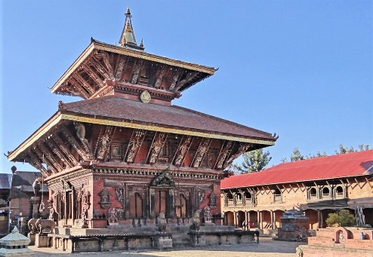
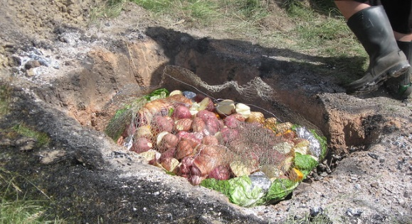
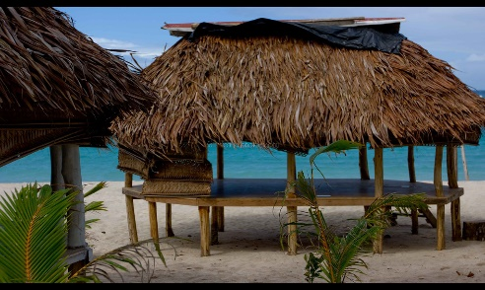
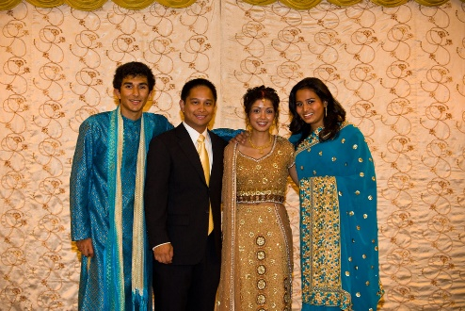
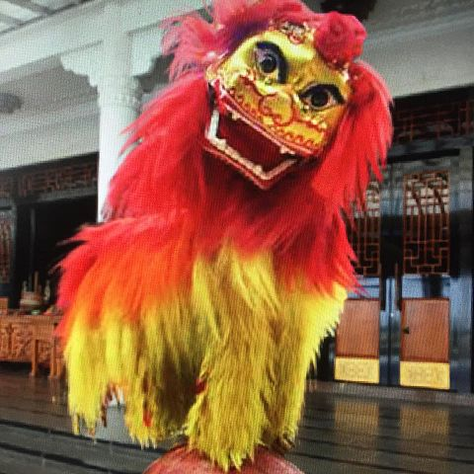
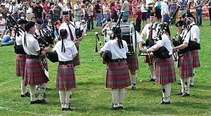
CULTURAL – Including the…
knowledge and skills that make up our ethnic and cultural intelligences and competencies plus their underpinning origins, history, ancestry and whakapapa of :
our genetically determined ethnicity(ies) and
our selected cultural ways of interacting, existing, living, and surviving in the various environments that make up our world.

Slide 17
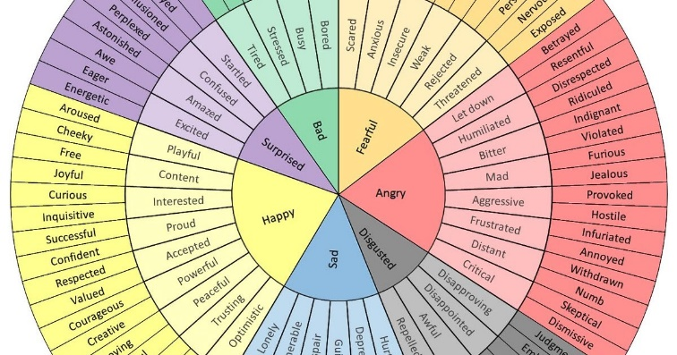
EMOTIONAL – Including…
All aspects making up our emotional intelligence
awareness of our emotional landscape and repertoire
emotion identification and impacts
expression of emotions
processing and what we can and cannot regulate

Slide 18
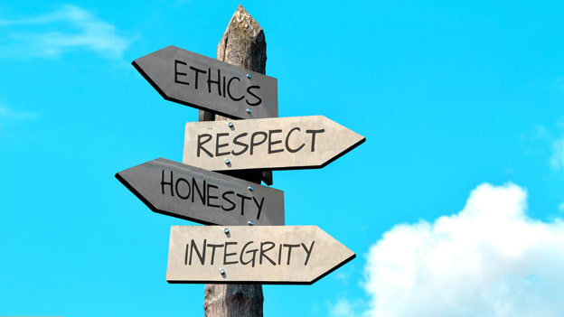
SPIRITUAL – Including…
the beliefs held which may or may not be religious in nature and which inform and frame interactive experience
the values held and what is valued and
a synthesis of the beliefs and values held and which informs the attitude with which the person approaches all interactive experiences in their life.

Slide 19
Key Universal Wellbeing Model characteristics…
it is holistic, its sum is greater than its parts
it is integrated, all dimensions are interlinked and interdependent
all dimensions are of equal importance and need balanced
it is responsive to diversity and differences (ethnic, cultural, belief etc…)
it is empowerment, and appreciation orientated
all dimensions and variables are underpinned by research and practice

Slide 20
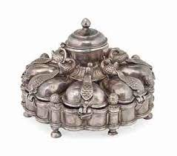
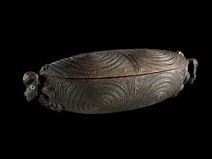
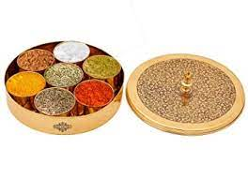
Key points about Wellbeing
Individuals, family, whānau and teams have a wellbeing profile, history whakapapa.
It could look good but be quite a mixture on examination.

Slide 21
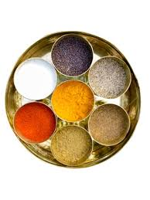
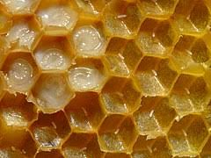
Key points about Wellbeing
3. Only after investigation can we see the state of different variables.
4. Like a honeycomb our wellbeing is linked to that of others, we are all
interconnected.

Slide 22
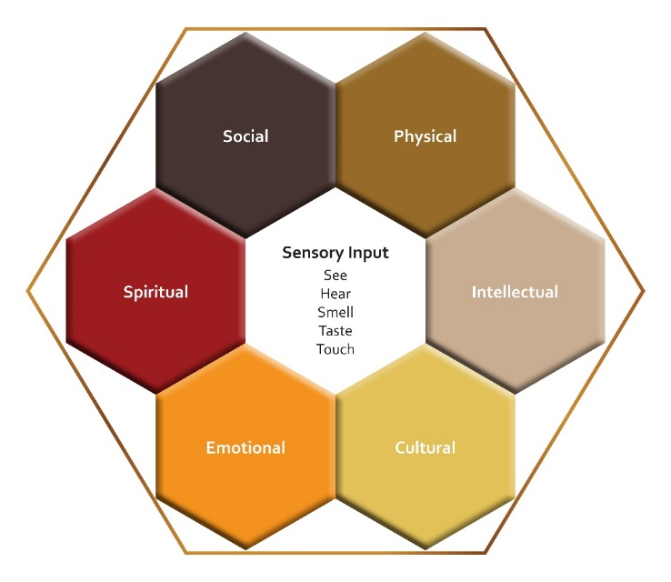
The Universal Wellbeing Evaluation Tool (UWET) Wellbeing Check
Social Variables |  | Physical Variables
Spiritual Variables |  | Intellectual Variables
Emotional Variables |  | Cultural Variables
Wellbeing Evaluation Tool (UWET)
Structure
(Stevenson, Gurung, & Zagala, 2022)

Slide 23
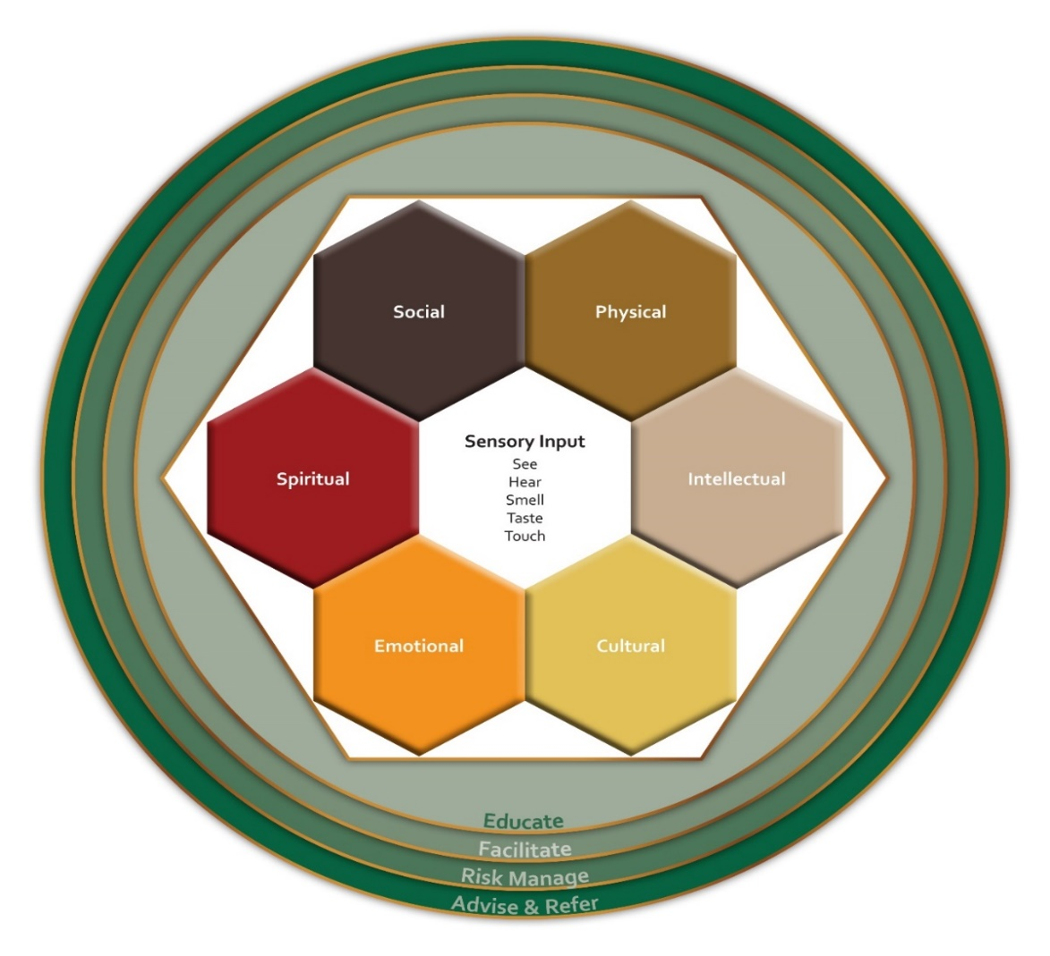
Universal Wellbeing Practice Guidelines (UWPG)
Professional Wellbeing Facilitators
Educate
Facilitate
Risk Manage
Advise & Refer

Slide 24
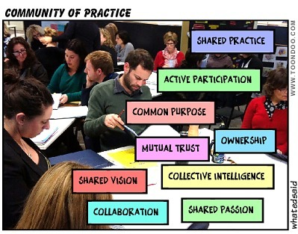
Professional Wellbeing Facilitators
Retain currency by:
i) Belonging to a ‘Community of Practice’
ii) Undertaking ‘Supervision’ over time (Confidential)
iii) Undertake Annual Certification Refresher courses or Conferences to continue development of emotional and cultural intelligences, critical, higher, associative, creative thinking, and other practice capabilities.

Slide 25
Universal Wellbeing Evaluation & Enhancement Process
Step 1
Professional Wellbeing Facilitators provide information to clients about the UWM.
Step 2
The Wellbeing Facilitator reviews the clients’ UWET Outcomes Report with them.
Step 3
The Wellbeing Facilitator and client monitor implementation of the Wellbeing Enhancement Plan over time.
The Wellbeing Facilitator serves as, advisor and referral resource to the client as they require.
The Wellbeing Facilitator then administers the UWET (Wellbeing Check) to the client.
The Client and Wellbeing Facilitator co-design a Wellbeing Enhancement Plan.

Slide 26
UWM Development Quality Criteria
Defined terminology
Underpinned by philosophy – beliefs, values and attitudes framework
3. Research and practice-based theoretical Model
4. Supported by evidence (from diverse contexts)
5. Supported by practice (from diverse contexts)
6. Guides quality professional wellbeing enhancement practice
7. Fit for purpose and functions
8. Makes a measurable difference in peoples lives

Slide 27
Invitation to be involved:
As a participant
As a student
As a member of a Community of Practice
As a CPE attendee
As a conference presenter
Contributor to the research
As an advocate for wellbeing enhancement….

Slide 28
References
Durie, M. (1994). Whairora: Māori Health Development. Oxford: Oxford University Press.
Graham, S. F. & Going. N. (2010 & 2026). Whare Tapa Rima – The Five-Sided Home. Published as a Poster (2016). Hamilton: FREEDOM Institute of Higher Education.
Moeau, P. (1997). Hauora. Paper presented at the Physical Education New Zealand Conference, Christchurch.
Fielden, Kay, Susan F. Stevenson, Nikki Going, Suzanne Grant, and Kristyl Zagala. (2020); Whare Tapa Rima – The Five-Sided Home: a best practice holistic learner support model project. Ako Aotearoa Norther Hub Project Colloquium. Auckland: Ako Aotearoa. https://ako.ac.nz/assets/Knowledge-centre/Whare-Tapa-Rima/Whare-Tapa-RimaGuidebook.pdf
Fielden, Kay, Susan F. Stevenson, Nikki Going, Suzanne Grant, and Kristyl Zagala. (2020); in Digital Video. Whare Tapa Rima. Ako Aotearoa Norther Hub Project Colloquium. Auckland: Ako Aotearoa. https://ako.ac.nz/knowledge-centre/whare-tapa-rima/whare-taparima-the-five-sided-home/ and https://www.youtube.com/watch?v=qQ3WsRfD9h0
Schofield, Anne, Lisa Walker, and Nikki Going. (2011). Supporting academic success to minority group students in a private tertiary establishment. Retrieved from Wellington, New Zealand.
Stevenson, S. F. (2021). Leading equitable outcomes for higher education students via implementation of the holistic Whare Tapa Rima-The five-sided home theoretical model. Conference V63. https://conference.herdsa.org.au/2021/program/prerecordedpresentations/ V63
Stevenson S.F., Zagala K.C. (2021). Future Institutional and Student Services Leadership Challenges: Implementing a Holistic Whare Tapa Rima – Five-Sided Home Model. In: Huijser H., Kek M., Padró F.F. (eds). Student Support Services. University Development and Administration. Springer, Singapore. https://doi.org/10.1007/978-981-13- 3364-4_11-1 Schofield, A., Walker, L. & Going, N., (2011). Supporting academic success of minority group students in a private tertiary establishment. Retrieved from Wellington, New Zealand.

Slide 29
Contact Us
NZCDI
Level 1/610 Victoria Street CBD, Hamilton
Or
1/28 Liverpool Street CBD, Hamilton
Telephone: 07 834 0451 or 027 3869296
Email: admin@nzcdi.ac.nz
Web: www.nzcdi.nz

Slide 30
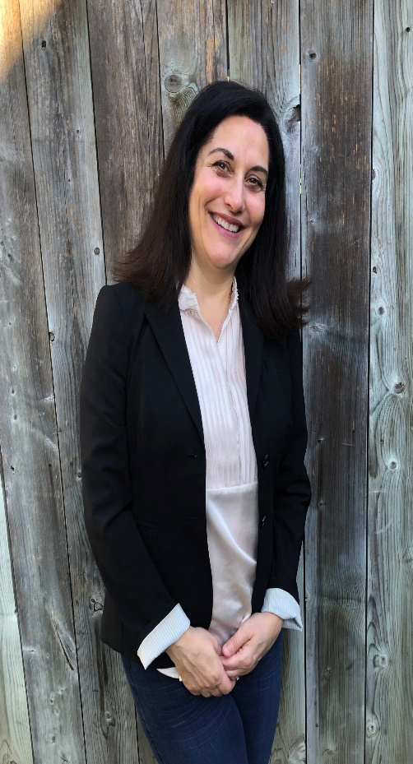
About the Universal Wellbeing Model (UWM)
About: Professional Wellbeing Facilitators
A Professional Wellbeing Facilitator’s practice objective is to empower those they work with to optimise their wellbeing through educating, facilitating, risk management, advice and referral practices.
Their facilitation is underpinned by aligned humanistic education, social sciences, health sciences, and psychological philosophies, theories, research and practice. Key knowledge and skills held by such facilitators include: communication, facilitation, planning, monitoring, risk management, advice giving, referral, and evaluation.
Experienced facilitators may also attain coordination, management, and leadership capabilities to further engage, and empower ownership by those they work with. Professional Wellbeing Facilitators will normally hold a graduate level qualification (or equivalent) and undertake ongoing supervised practice to ensure maintenance of professional boundaries, professional, and ethical conduct standards.

